Slide 1



OpenTelemetry Traces Metrics Logs
Conclusion Code Café – 17 november 2022
Lucas Jellema, CTO & Architect AMIS | Conclusion

Slide 2
Telemetry - Observability
What/Why
detect anomalies and trends/patterns
find the when and where
analyze what has happened
when, where, how, with which result, how long did it take
analyze the current status
report
Ensure proper operations (non-functional)
Assist in problem analysis and resolution
Inform stakeholders
Ops during Production
and also during development and test

Slide 3
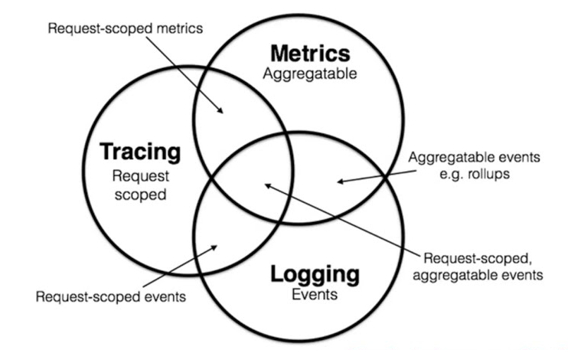
Three types of telemetry signals
Metrics
status report at one moment in time or over a recent time window
Traces
correlated steps for a request | transaction | conversation
reporting sequence of where, when, how long, context | result
Logs
timestamped reports on events in operating system, platform components or custom applications

Slide 4
Different levels/dimensions of telemetry
Business / Functional ⬄ Non Functional, Technical
High level ⬄ fine grained
Custom ⬄ generic
frameworks
platform
operating system
container engine

Slide 5
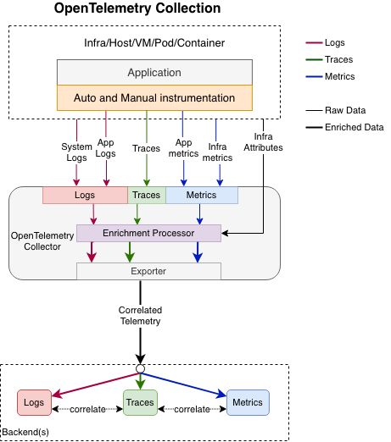

Slide 6
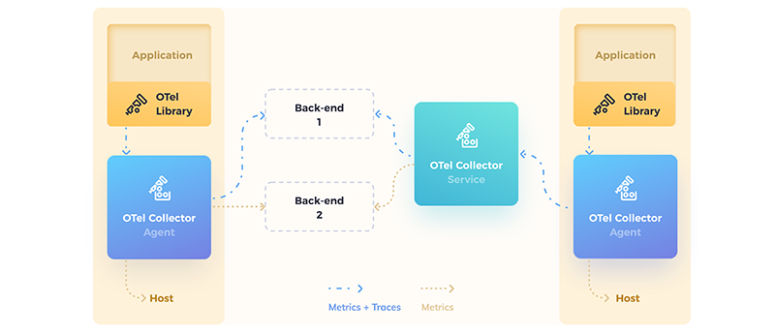
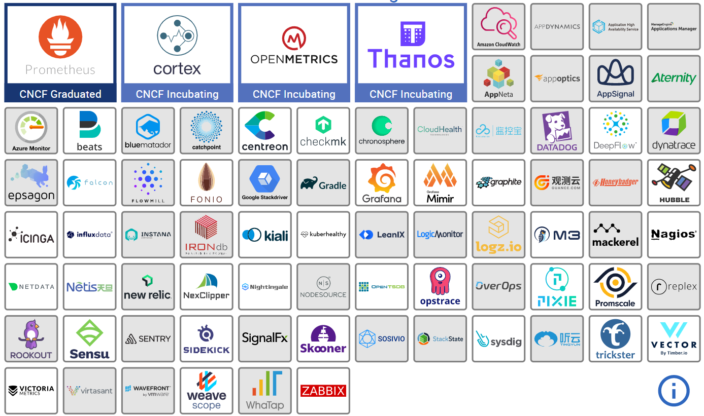
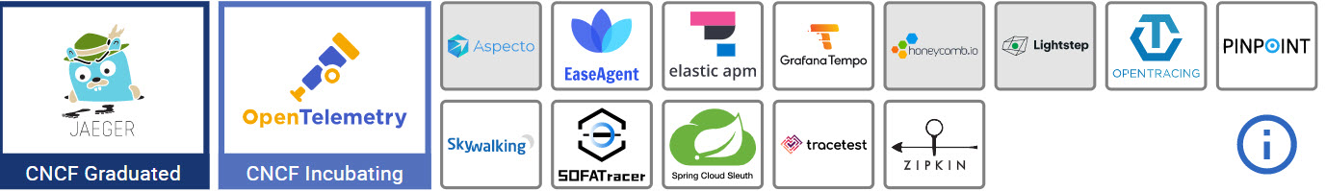
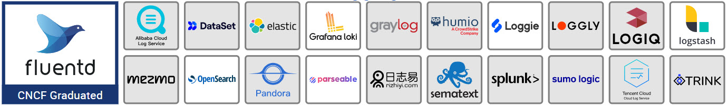
OpenTelemetry
Standardize collection of metrics
provide to observability platform of choice
CNCF Incubating project – widely embraced
SDKs & Client Libraries for instrumenting applications
produce trace, log, metrics
auto-instrumentation and app specific custom instrumentation
Telemetry collection via Local Agent and Central Collector service
also: routing / forwarding
Many tool can act as or import from an OTel collector (some can export to)
Jaeger, Prometheus, Dynatrace, Signoz, Logz.io, fluentd LogicMonitor, ElasticAPM, New Relic, Azure Monitoring, …
Notes:
https://opentelemetry.io/registry/

Slide 7
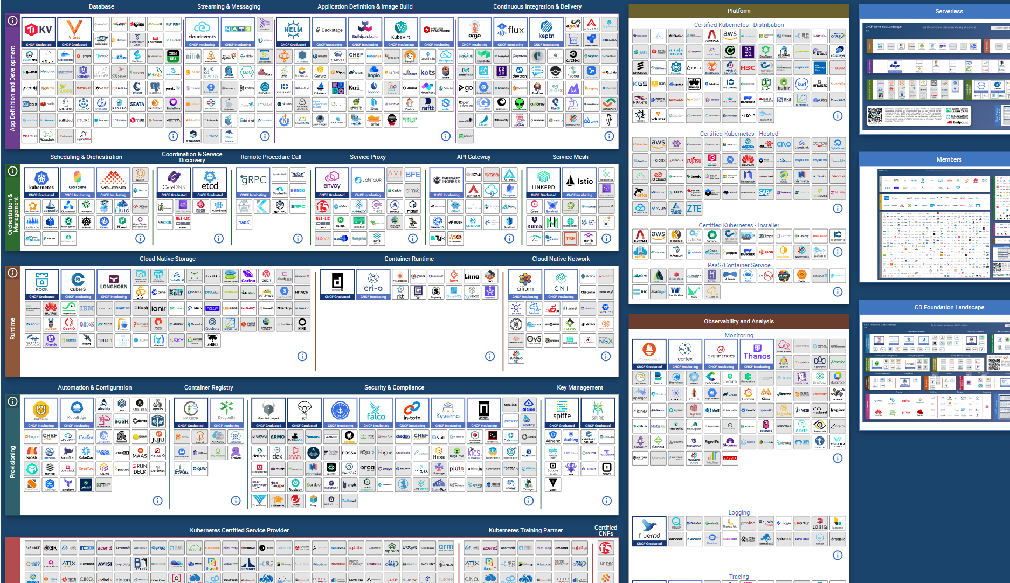

Slide 8

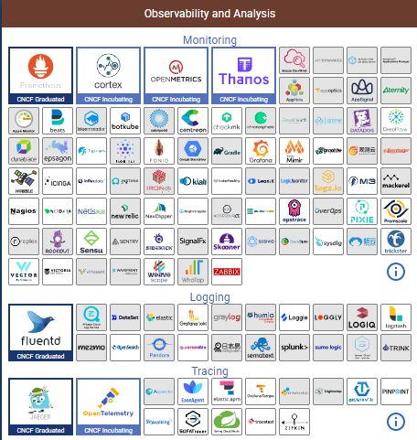

Slide 9
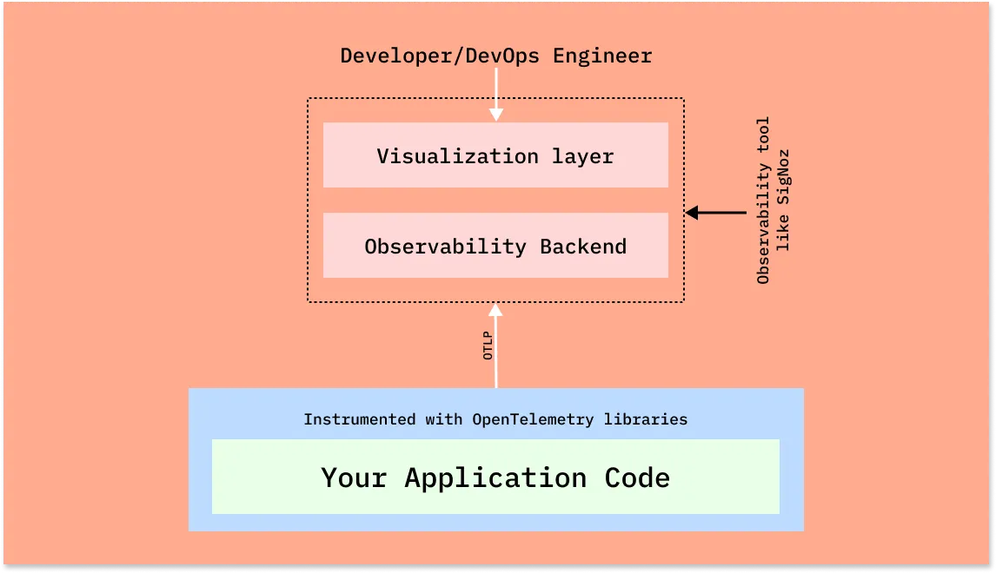
Instrumentation – Automated & Custom
Web Applications
JavaScript Browser SDK
main frontend frameworks
Backend
main programming languages and frameworks
External Calls
database (JDBC), APIs (HTTP), queues, file system
Platform
JVM, Java application servers
Kubernetes
distributed (correlated) trace-spans, metrics, logs
environment variables

Slide 10
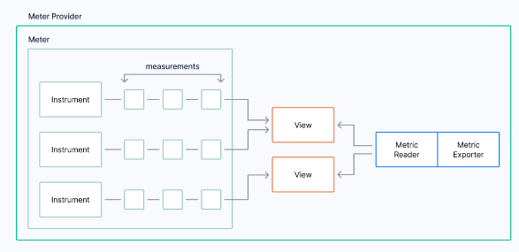
Metrics
Instruments observe and produce Measurements
Measurements are processed by a View: filtered, aggregated, transformed
resulting in Metrics
Metrics are handled by Metrics Readers associated with Metrics Exporters (push or pull)
Metrics can be labeled
Data can be scraped into OTLP Collector from existing Prometheus Exporters
OTLP Collector can publish metrics as Prometheus Exporter
Prometheus (push/pull) , Console (push), OTLP (push)
Notes:
https://www.timescale.com/blog/a-deep-dive-into-open-telemetry-metrics/

Slide 11
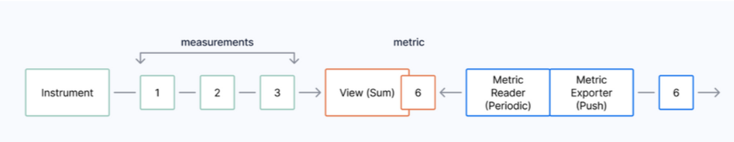

Slide 12
Types of Metrics
Counter (synchronous and asynchronous – push and pull via callback)
UpDownCounter (synchronous and asynchronous – push and pull via callback)
Histogram (buckets)
Asynchronous Gauge (record of non summable values)
Aggregation types for Measurements (in Views)
Sum Aggregation, Last Value Aggregation, Histogram Bucket Aggregation

Slide 13
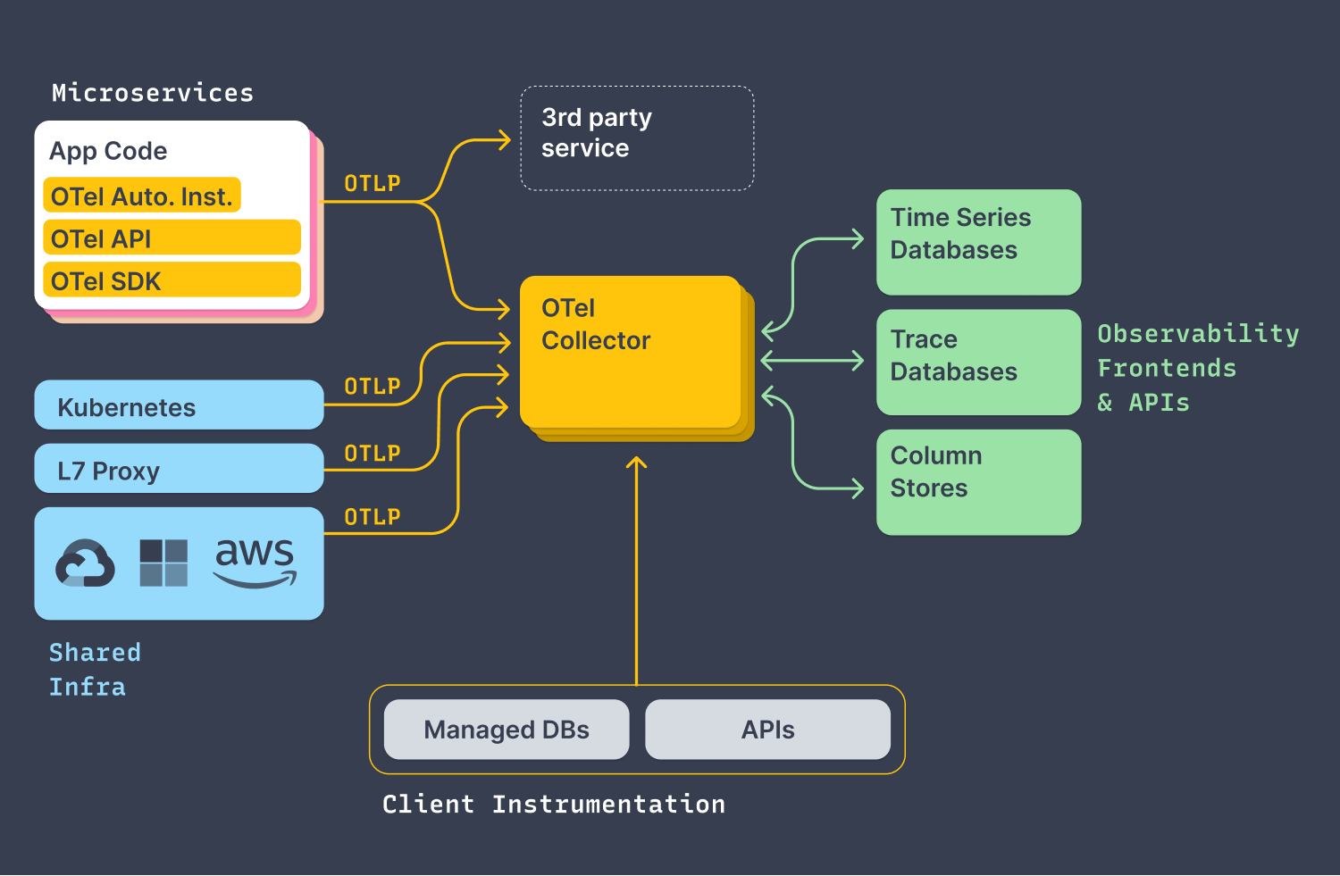

v

Slide 14
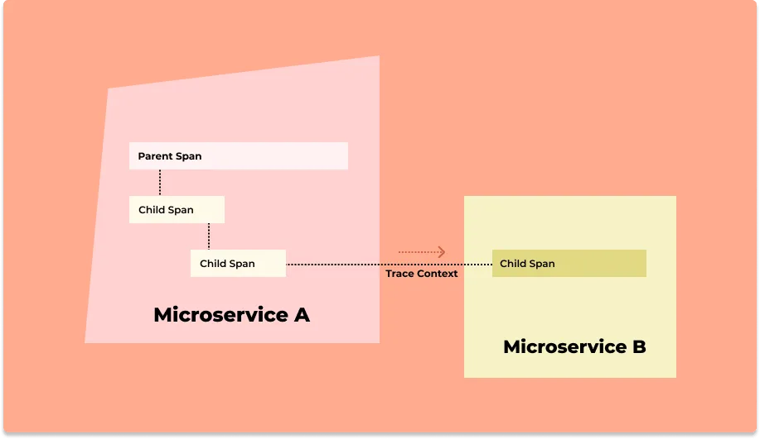
Trace – step by step documenting the end to end flow
Trace
trace id, resource, begin & end timestamp, context, status

Slide 15
Tracing – Spans mark boundary crossing – within a process and across services, servers, domains
Web Application
trace id, resource, begin & end timestamp, context, status
Trace
3rd party API
Parent Span
Child Span
Child Span
Child Span
Database

Slide 16
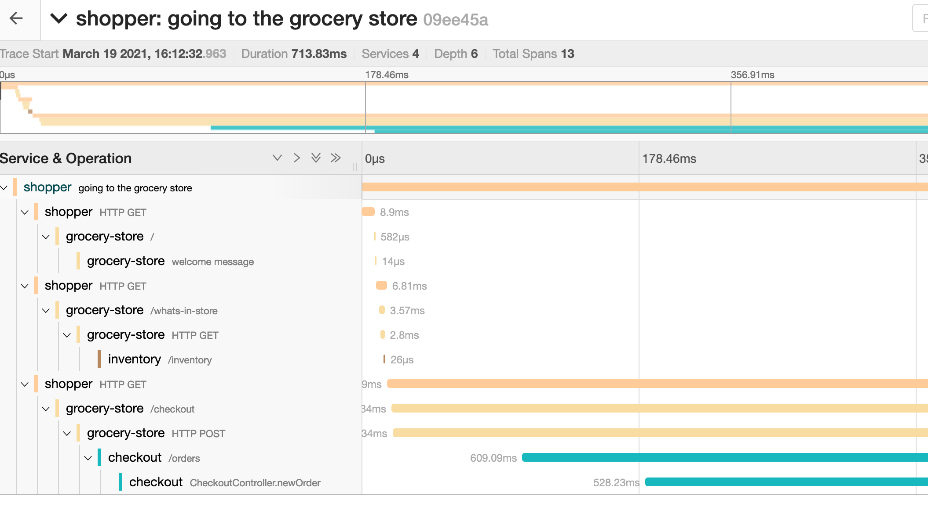
Tracing
Correlated sequence of steps – per request | transaction | conversation
within and across processes and servers
begin & end timestamp
trace context
parent / child span
span event
span link (causal relationship across traces)
Notes:
https://opentelemetry.io/docs/concepts/signals/traces/#span-links

Slide 17
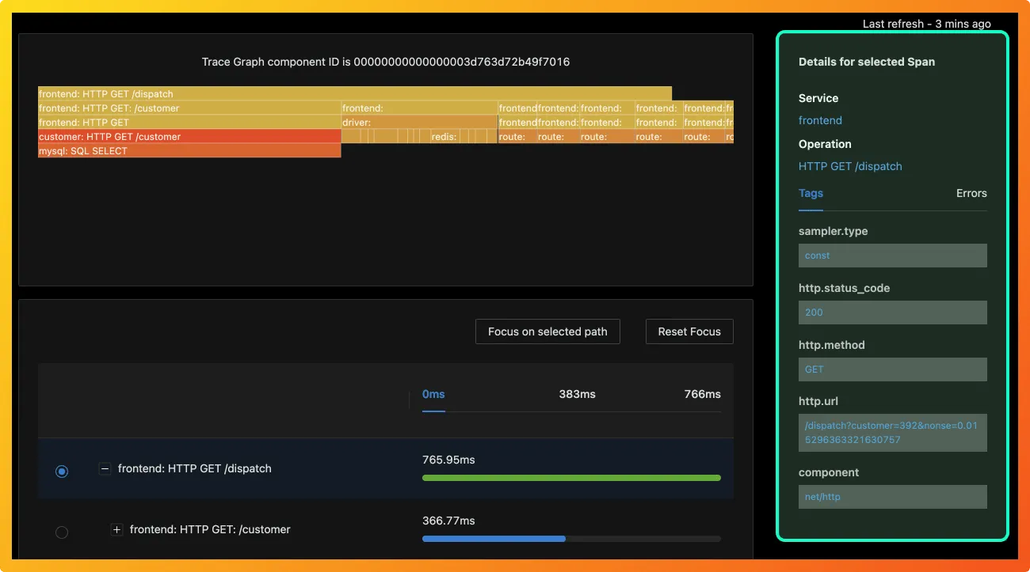
Tracing

Slide 18
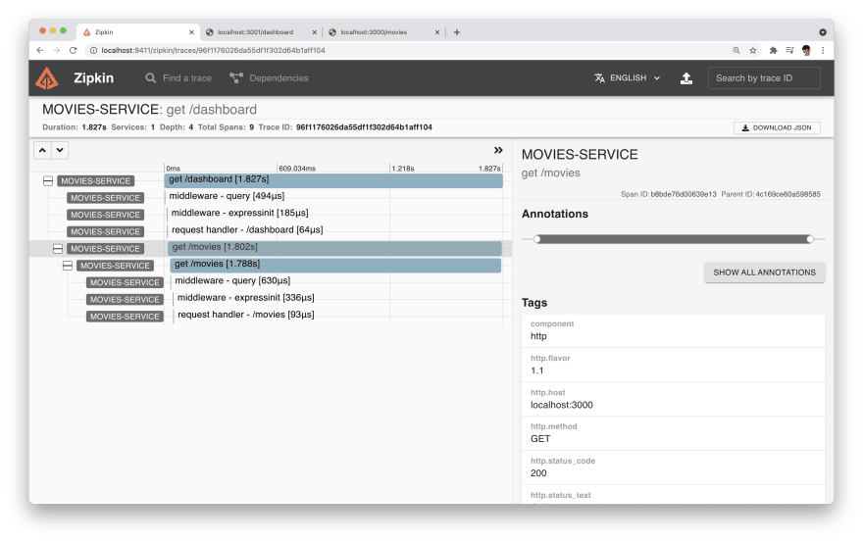
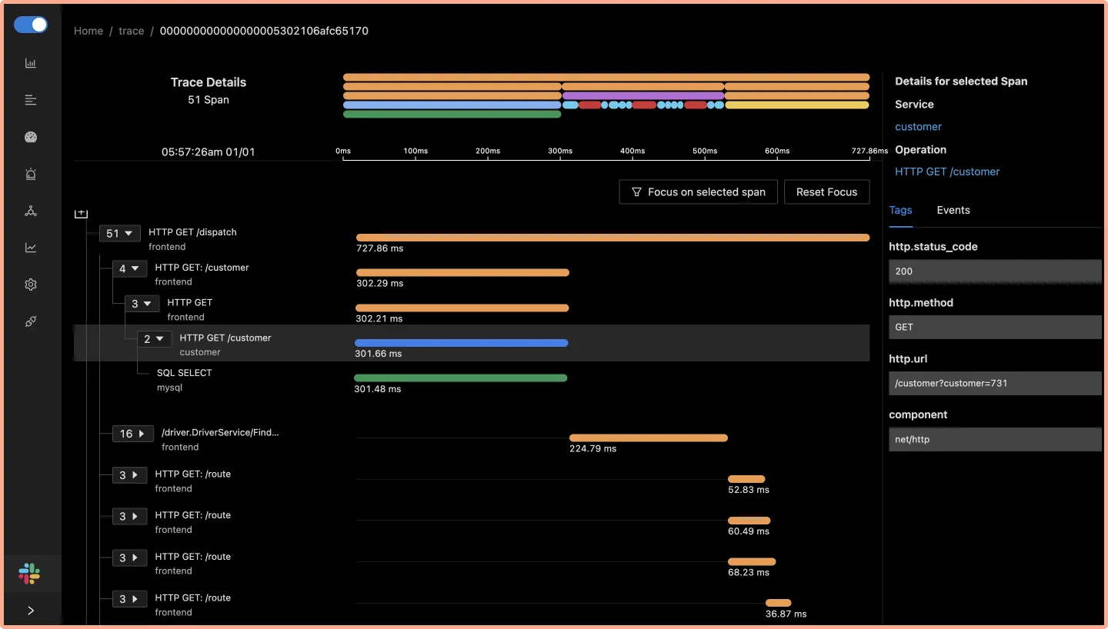
Tracing Auto-Instrumentation
Without code changes – producing traces and spans
only by configuring the appropriate instrumentation
For example
start span for HTTP request, database call
How to auto-instrument?
include (and configure) libraries
configure Java Agent when starting JVM

Slide 19
Log
Types of log: operating system, network, web server, API gateway/proxy, application – frameworks, libraries, custom
OpenTelemetry needs to support the existing legacy of logs and logging libraries
OpenTelemetry collector provides a syslogreceiver to receive System logs.

Slide 20
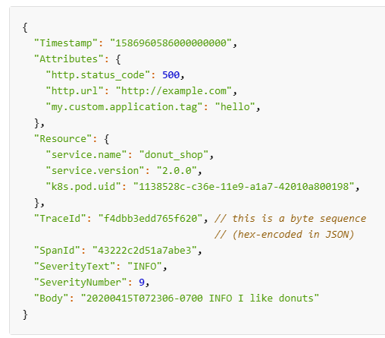
OpenTelemetry Log Format
Include trace and span identifier
enabling correlation between traces and logs
Also add trace-flags: severity text and number, (re)source, scope, attributes
Auto-instrumentation – extend behavior of existing logging libraries
without code changes
add incoming request context
Notes:
https://opentelemetry.io/docs/reference/specification/logs/data-model/

Slide 21
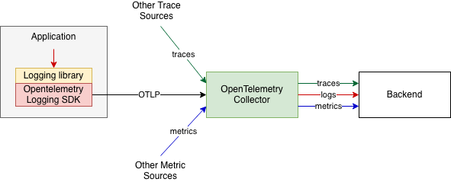
Log
Directly log from application to OpenTelemetry Collector
using OpenTelemetry extensions and addons in commonly used logging libraries

Slide 22
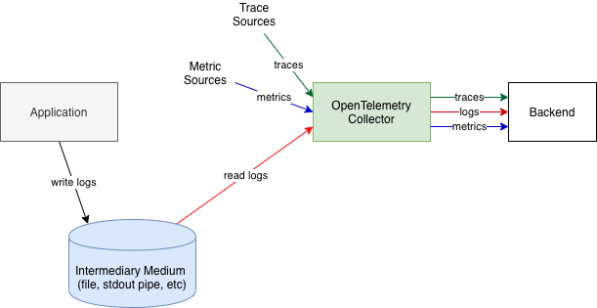
Log
Indirect log-shipping fetching into OpenTelemetry Collector

Slide 23
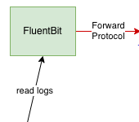
Log
Indirect log-shipping to OpenTelemetry Collector using FluentBit

Slide 24
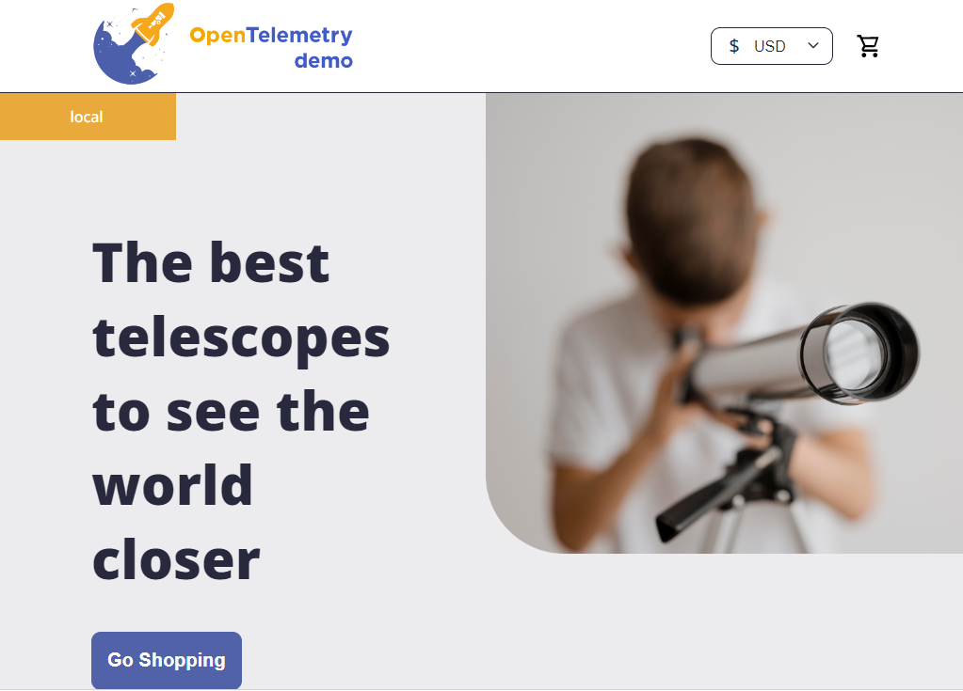
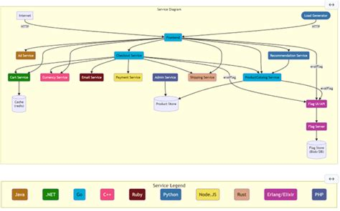
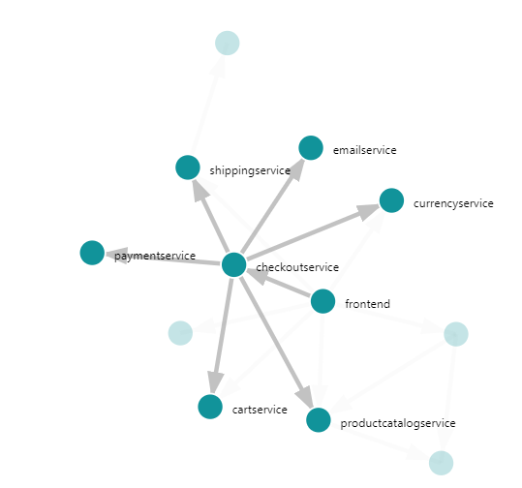
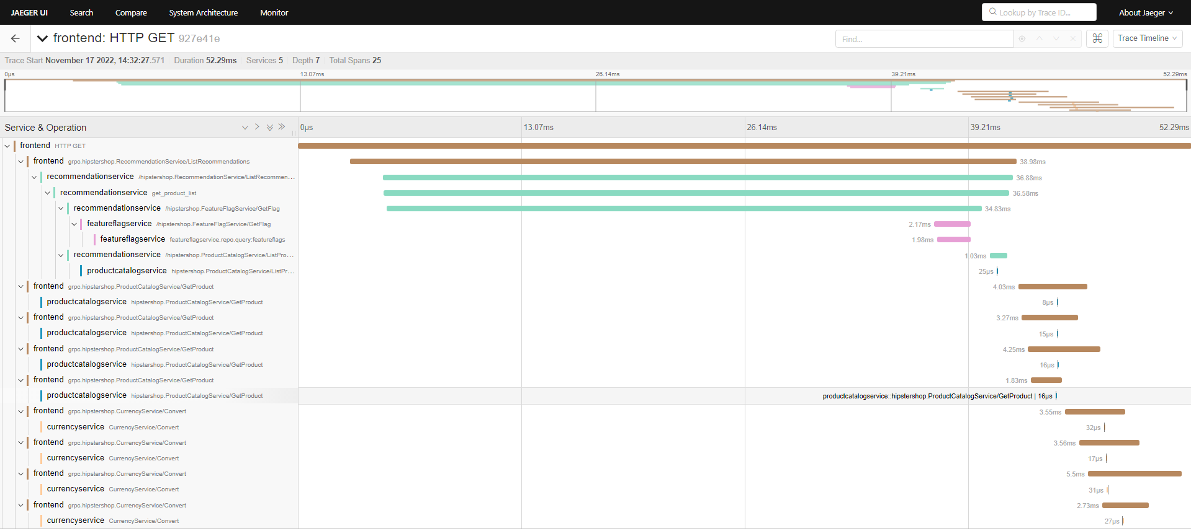
OpenTelemetry Demo - Showcase
Frontend
Services
Databases
Polyglot
Instrumented
Jaeger. Prometheus and Grafana included

Slide 25
Summary
OpenTelemetry is a standard for producing and collecting Telemetry
Traces, Logs, Metrics
Supported by all players in the industry
OpenTelemetry offers OTLP Collector and libraries/SDKs to easily instrument applications
by including explicit coding instructions
through auto-instrumentation (formerly paid options with commercial tools)
Traces help provide multi-hop | - tier insight
Dozens of monitoring | log analysis | metrics oriented tools can handle OpenTelemetry
No reason not to start instrumenting your stuff

Slide 26

Hands On Labs and Environments
QR Code for gist that provides links to all Hands On Instructions
Three Hands On:
Backstage – instance in Gitpod workspace
Gitpod – workspace to try out special configuration & features
OpenTelemetry – Gitpod workspace
for running simple instrumented Node application
for installing and running end-to-end, polyglot OpenTelemetry demo
Notes:
https://gist.github.com/lucasjellema/c661c7cdfab658ae925c860a69642981

